Slide 1
BRITISH AIRWAYS
Web scrapping Reviews and it’s Results

Slide 2
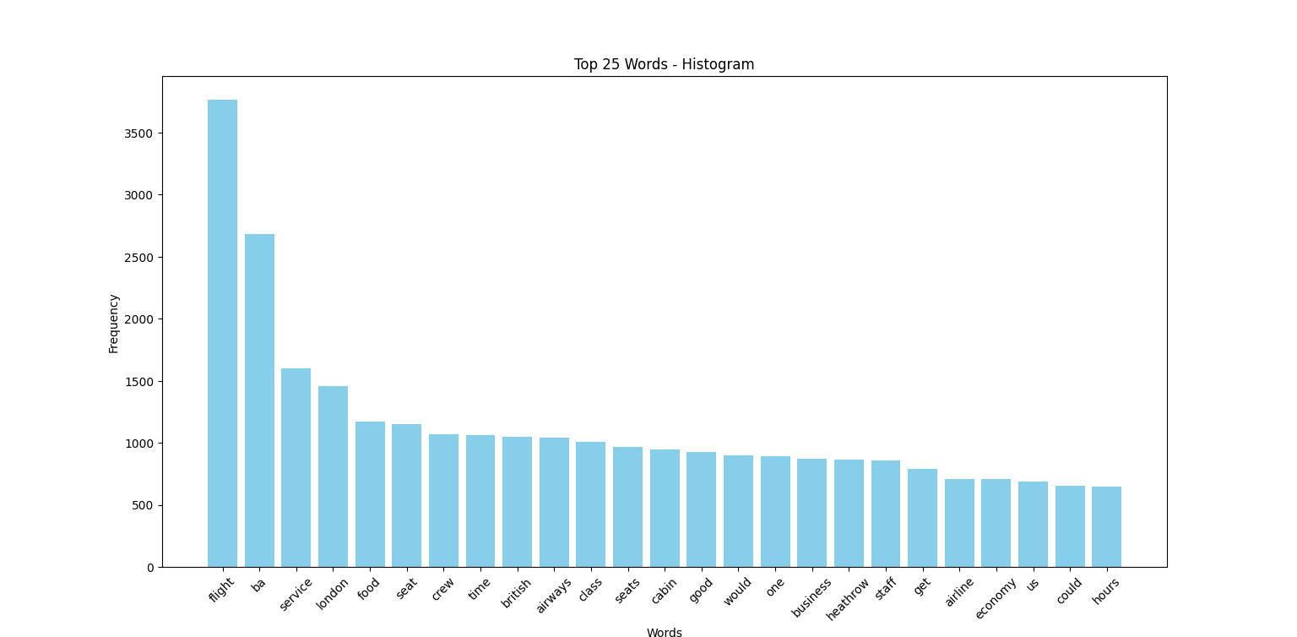
Web scrapping reviews analysis
After extracting the reviews of the airline an analysis was done to find the most common word from the bag of words and the top 25 word that have the highest frequency are plotted on the graph.

